Slide 1

Shopping Customer Segmentation
Using KMeans Clustering to Identify Key Customer Segments s By: Joseph Choi

Slide 2
Table of Contents
Introduction
Exploratory Data Analysis (EDA)
Model Development (KMeans Clustering)
Key Findings
Marketing Strategy Recommendations

Slide 3



Introduction
Problem Statement: The marketing team needs to better understand the target customers to develop effective marketing strategies. Identifying distinct customer groups based on demographics and purchasing behavior is crucial for developing marketing efforts and optimizing customer engagement.
Project Objective: Perform customer segmentation using an unsupervised machine learning technique, KMeans clustering, to divide the customer base into meaningful segments based on demographic and behavioral characteristics. Identify target groups for marketing to improve strategic decisions and customer satisfaction/retention.
About the Dataset: The dataset consists of entries representing shopping customers at a mall. It contains the following features: Customer ID, Gender, Age, Annual Income, and Spending Score (1-100) assigned by the mall based on customer spending behavior and purchasing patterns.

Slide 4
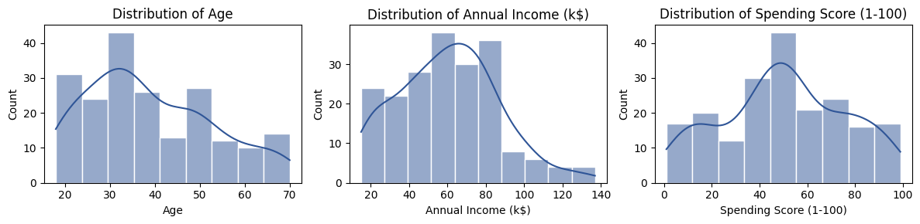
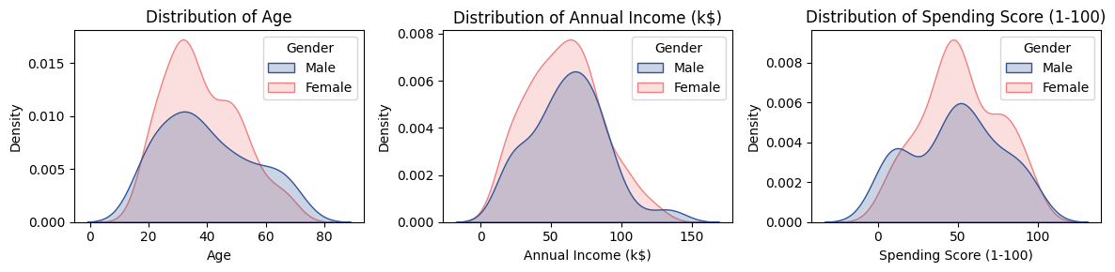
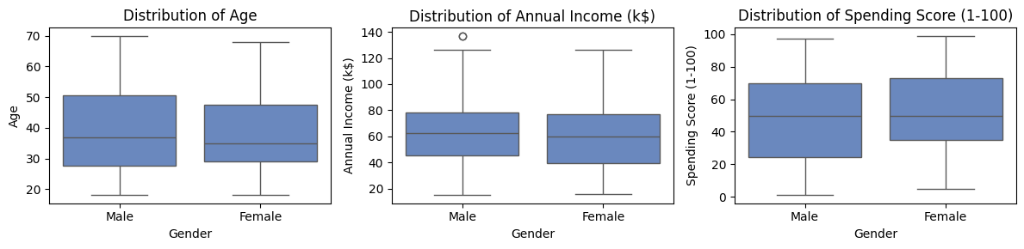
Exploratory Data Analysis Univariate Analysis
Histograms:
Age: Peaking in the 30s, dropping after 50
Annual Income: Right-skewed, most earn 40k-80k, few above 100k
Spending Scores: Normal distribution; most are moderate, with few extremes
KDE Plots:
Higher density peaks for females
Females cluster to specific values more than males
56% females, 44% males
High-income outliers among males
Box Plots:
Males: Slightly higher median age and income, more variability, high-income outliers
Females: Slightly higher median spending scores, more overall spending

Slide 5
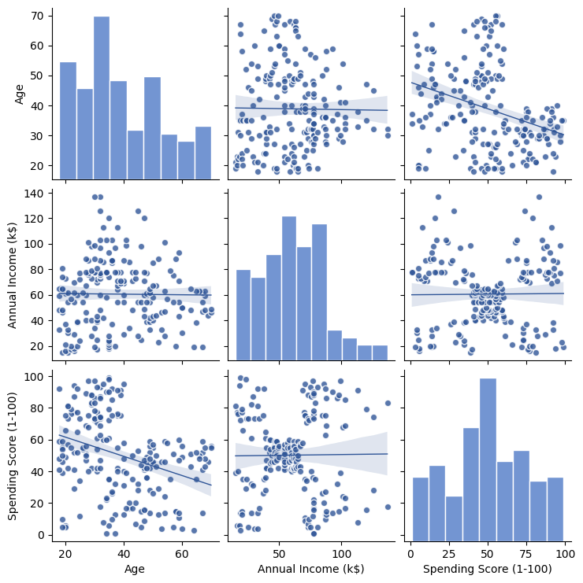
Exploratory Data Analysis Bivariate Analysis - Part 1
Pair Plot:
No strong relationship between age and income, suggesting minimal impact of age on annual income
Negative relationship between age and spending score, indicating customers spend less as they get older
Noticeable grouping pattern between spending and income, suggesting five distinct clusters
These groupings indicate natural segments within the data, useful for customer segmentation and target marketing strategies

Slide 6
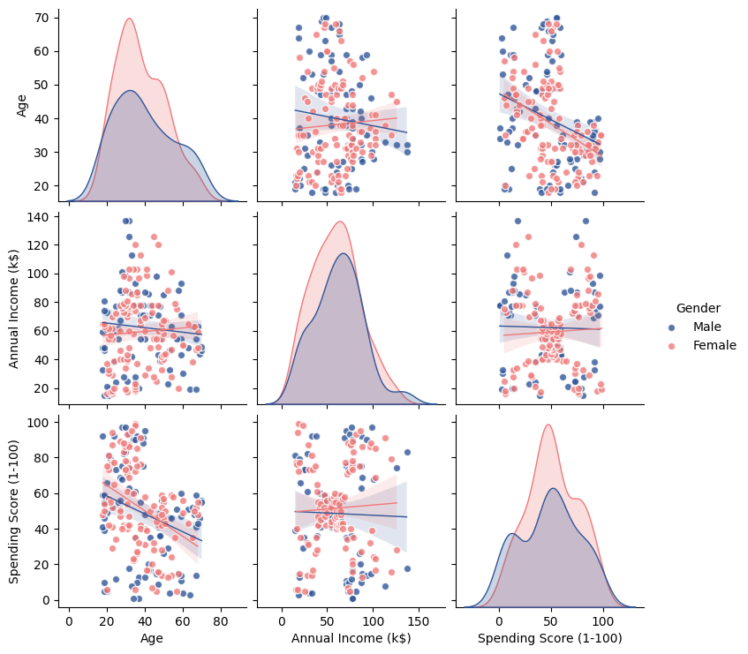
Exploratory Data Analysis Bivariate Analysis - Part 2
Pair Plot w/ Gender:
Regression line for males shows a negative slope for age and income, indicating income decreases with age for males
Regression line for females shows a positive slope for age and income, indicating income slightly increases with age for females
Both regression lines for age and spending score have a negative slope, with females showing a steeper decline
Female spending decreases more sharply with age compared to males
The five segments seen in the previous pair plot are still present for income and spending score
These segments highlight the need to explore these groupings for better customer segmentation

Slide 7
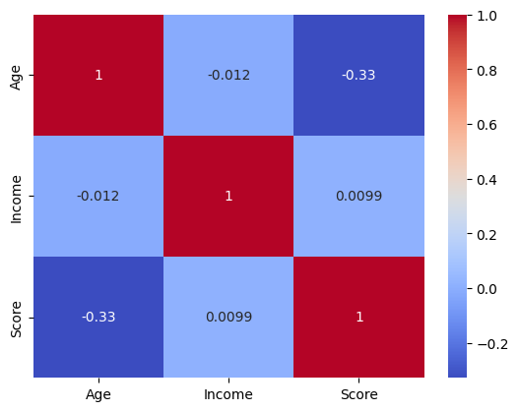
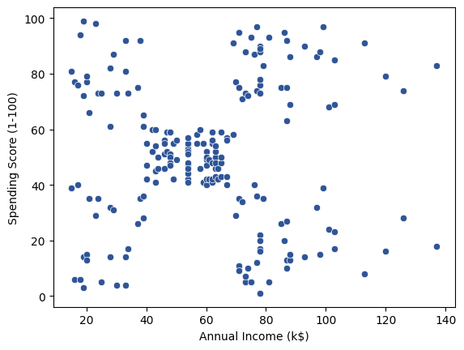
Exploratory Data Analysis Bivariate Analysis - Part 3
Correlation Heat Map:
Aligns with trends from the pair plot's regression lines
Correlation coefficients show relatively low numbers
Indicates weak relationships between features
Scatter Plot:
Plotted to explore the five segments observed in the spending score and annual income plot
Indicates distinct clusters of customers with varying income and spending behaviors
Description of each observed segment:
Top Left: Low Income, High Spending
Top Right: High Income, High Spending
Middle: Moderate Income, Moderate Spending
Bottom Left: Low Income, Low Spending
Bottom Right: High Income, Low Spending

Slide 8
Model Development Part 1
Initialization and Fitting:
Introduced and fitted the KMeans clustering model to the dataset
Utilized features: Annual Income and Spending Score
# Setup
from sklearn.cluster import KMeans
# Initiating KMeans clustering model
mallcustomer_cluster = KMeans()
# Fitting the model to annual income & spending score columns to form clusters
mallcustomer_cluster.fit(mallcustomer_df_mb[['Annual Income (k$)','Spending Score (1-100)']])

Slide 9
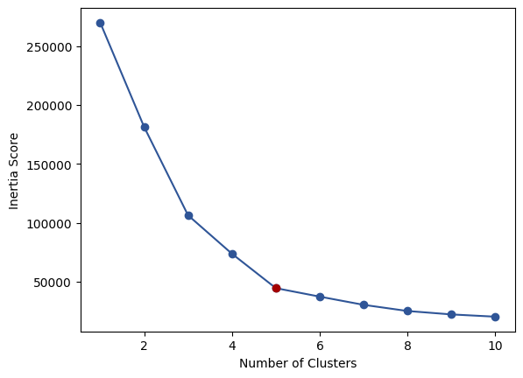
Model Development Part 2
Inertia and Elbow Method:
Applied the inertia and elbow method to determine the optimal # of clusters
Selected 5 clusters based on the elbow plot
# Looping through a range of cluster numbers from 1 to 10 to calculate the inertia scores for each cluster count
for range_i in range (1,11):
kmeans_model=KMeans(n_clusters=range_i)
kmeans_model.fit(mallcustomer_df_mb[['Annual Income (k$)','Spending Score (1-100)']])
inertia_scores.append(kmeans_model.inertia_)
# Plotting the inertia scores against the number of clusters to visualize the elbow method
plt.plot(range(1,11), inertia_scores, marker='o', color='#2F5597')
plt.title('Inertia vs Number of Clusters')
plt.scatter(5, inertia_scores[4], color='#A40000', zorder=5)
plt.xlabel('Number of Clusters')
plt.ylabel('Inertia Score');

Slide 10
Model Development Part 3
Cluster Labeling:
Re-initializing and fitting the model with the optimal number of clusters
Assigned numeric cluster labels
Mapped numeric labels to descriptive cluster names for better interpretation
mallcustomer_cluster = KMeans(n_clusters=5)
mallcustomer_cluster.fit(mallcustomer_df_mb[['Annual Income (k$)','Spending Score (1-100)']])
mallcustomer_df_mb['Spending and Income Cluster'] = mallcustomer_cluster.labels_
cluster_labels = {
0: 'Avg Income, Avg Spending',
1: 'High Income, High Spending',
2: 'Low Income, High Spending',
3: 'High Income, Low Spending',
4: 'Low Income, Low Spending'}
mallcustomer_df_mb['Cluster Label'] = mallcustomer_df_mb['Spending and Income Cluster'].map(cluster_labels)

Slide 11
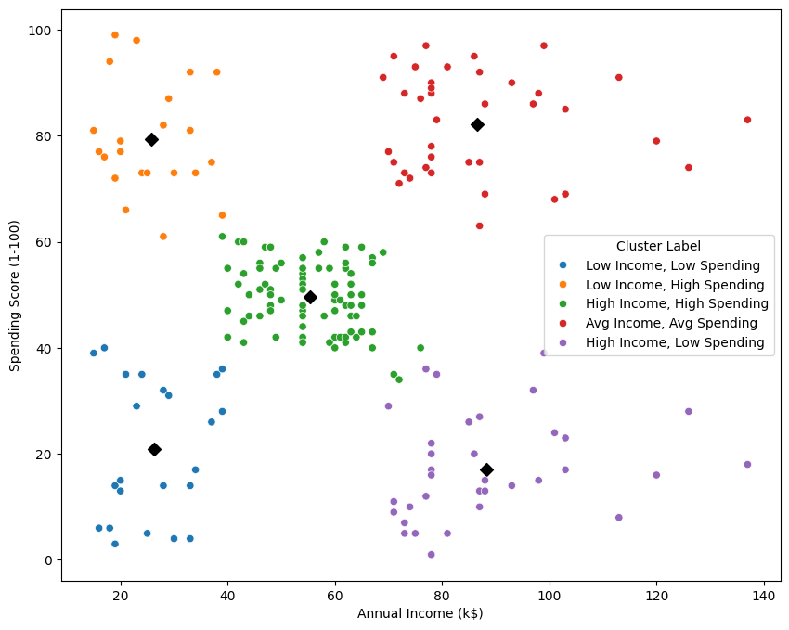
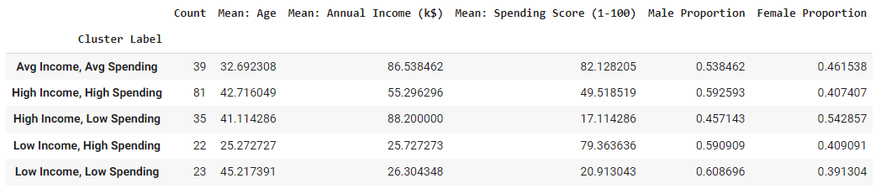
Key Findings Univariate Analysis
From the KMeans Clustering, I identified five distinct clusters:
Avg Income, Avg Spending: Consists of customers with moderate income and spending habits, forming the largest group
High Income, High Spending: Includes high-income, high-spending customers
Low Income, High Spending: Features customers with low income but high spending scores, suggesting they prioritize shopping despite lower earnings
High Income, Low Spending: Made up of high-income, low-spending customers, possibly indicating a focus on saving
Low Income, Low Spending: Includes those with both low income and low spending scores
Age vs. Spending Scores:
Younger customers tend to spend more:
Low Income, High Spending (avg. age 25)
Older customers tend to spend less:
High Income, Low Spending (avg. age 41)
Low Income, Low Spending (avg. age 45)

Slide 12
Marketing Strategy Recommendations
To effectively target each customer cluster, employ specific strategies:
High Income, High Spending: Premium loyalty programs and exclusive deals
Low Income, High Spending: Discounts, installment plans, or cashback offers
High Income, Low Spending: Promote savings, investments, and high-end products
Low Income, Low Spending: Value-for-money products and loyalty rewards for frequent small purchases
Avg Income, Avg Spending: Maintain loyalty with consistent value and personalized recommendations
Younger Customers: Trendy, personalized marketing through social media and mobile-friendly shopping

